Slide 1
HEART TO HEART

Slide 2
TABLE OF CONTENTS
1
2
3
4
PREAMBLE
IDEA
A brief introduction of the problem and proposed solution.
Describing the functionality of the web app
RELEVANCE AND USE
OUTRO
Discussing the benefits of health application
Future scope and conclusion

Slide 3
1
PREAMBLE
A brief introduction of the problem and proposed solution.

Slide 4
INTRODUCTION
Heart disease describes a range of conditions that affect your heart. Diseases under the heart disease umbrella include blood vessel diseases, such as coronary artery disease; heart rhythm problems (arrhythm). While heart disease can be deadly, it’s also preventable in most people. By adopting healthy lifestyle habits early and keeping track of the performance of your heart, you can potentially live longer with a healthier heart. Apart from Heart diseases, there are various types of diseases that can affect different parts of a human body like Diabetes, Blood Pressure, etc.

Slide 5
PROBLEM STATEMENT
We all are well aware of the fact that the number of patients of age 30 and above are more prominent to heart diseases and this number is increasing rapidly.It is a leading cause of death for older generation . Also, since the availability of doctors nowadays is very less and many people are not able to afford the consultation. Therefore, In order to tackle this problem, our team has built a web application which would help the user to keep a track of their heart’s health and we attempt to contribute towards a person’s healthy heart.

Slide 6
SOLUTION
We have created a web application which helps to predict whether the person is suffering from a heart disease or not. If yes, then we try to help them by suggesting some first aid solutions.In addition to that we keep the track of the user’s heart so that he/she can compare the improvement of their heart with the previous time they took the test and take care of their heart. To make it user-friendly we have added an additional audio feature, especially for those people who find it difficult to use a mobile application.

Slide 7
2
IDEA
Describing the functionality of the web app

Slide 8
In order to transform our idea into reality, we have used certain technologies. Firstly, to predict whether the person is suffering from a heart disease or not, we’ve used a Machine Learning algorithm. Out of all the algorithms the most accurate result was obtained from ‘Logistic Regression’. It is a supervised learning classification algorithm used to predict the probability of a target variable. The working accuracy of this algorithm came out to be 90%. After predicting, we found out that maximum number of people are at the risk of having a heart problem.

Slide 9
With further advancement, we have used Natural Language Processing algorithm to include the audio feature which would not only recognize speech but also classify the user’s mindset based on his/her tone to create a detailed analysis report.

Slide 10
Secondly, we’ve built a web page using Html and CSS for the login details of the user which would be asking for their ‘Name’ and ‘email Id’. Then we’ve provided a button which would direct them to the form which is built again using html and CSS, where the user is going to fill in his/her details. After filling the details the user will submit the form and based on our predictions he/she will get to know whether they are suffering or maybe at a verge of having a heart disease or not. If yes, then we’ve suggested certain measures that they can take in order to avoid any further problem.
Now in order to make this web application available to the user, we’ve deployed both ML model and Web page using ‘FLASK’ framework.

Slide 11


Slide 12
TECHNOLOGY STACK
For Web Development
For ML Model
HTML
CSS
JAVASCRIPT
PYTHON
FLASK
NLP

Slide 13
54%
According to our dataset more than
are either suffering from heart disease or are on the verge of suffering.

Slide 14
3
RELEVANCE AND USE
Discussing benefits of health application

Slide 15
RELEVANCE AND USE
Blessing for Far Remote Areas.
Reduces Risk of the Wrong Diagnosis.
Reduction in Medical Bill and Expenses.
Health applications are boon for doctors and medical staff.
Patients can monitor their health personally.
Delivering patient care at home.
1
2
3
4
5
6

Slide 16
APPLICATION AND UTILITY
Assist individuals in monitoring their own heart conditions.
Allows virtual interaction of doctors and patients.
Helps to keep track of medications.
Affordable Consultation fee.

Slide 17
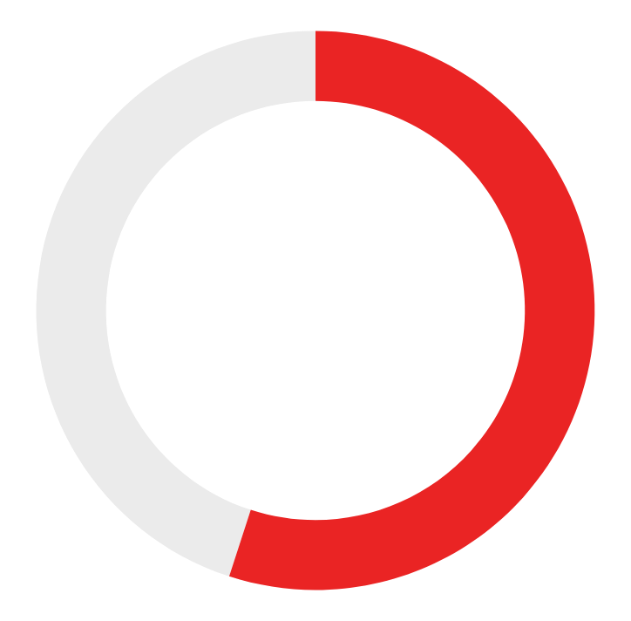
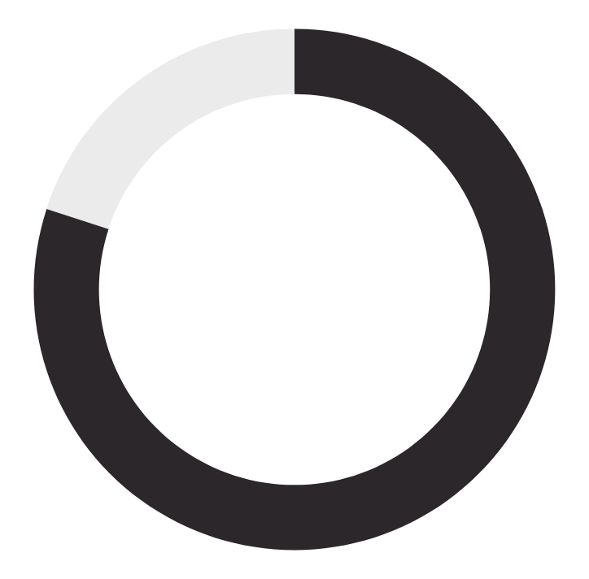
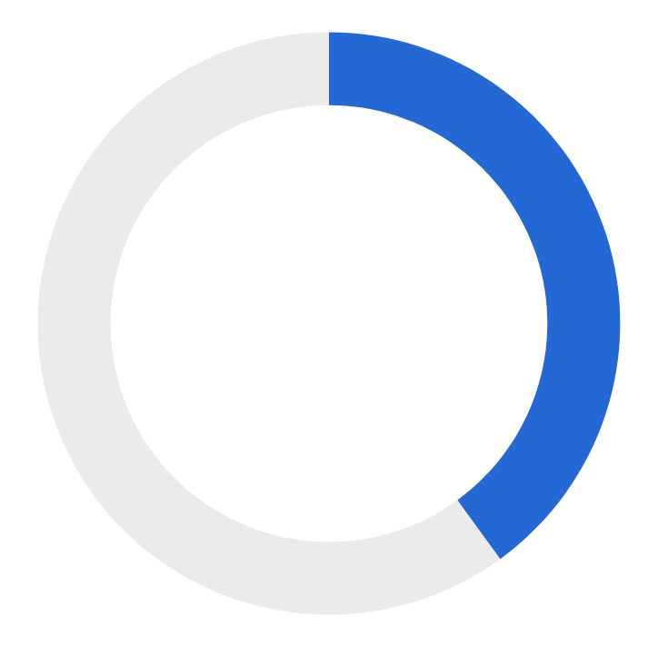
SOME FACTS
of physicians believe that health applications can improve patient’s health
Of physicians use their applications to assist in day-to-day practices.
Of health applications target wellness-- like fitness & nutrition.
93%
90%
75%

Slide 18
4
OUTRO
Business value and Future scope

Slide 19
COST OF IMPLEMENTATION AND FEASIBILITY
Since the web application is based on software therefore no software cost is applied. However, for maintaining large database the servers will be required to spend around Rs. 500 as the installation cost.
If some special support is provided by professional healthcare then they will prefer to keep a buffer of Rs. 2000 monthly approx.
It will initially be free for 30 days for all users but later users can avail subscriptions as:
MONTHLY-Rs 99 YEARLY-Rs 699

Slide 20
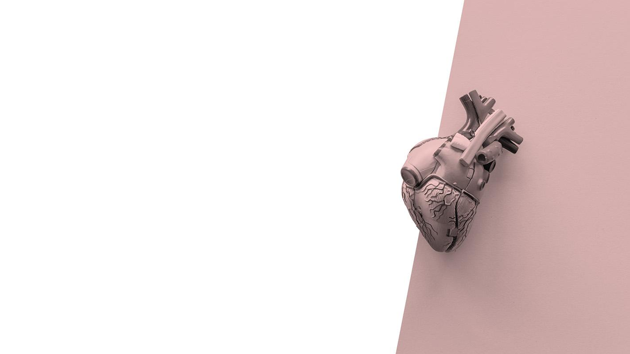
FUTURE SCOPE
For time being our application is constrained to heart but we can further expand it by incorporating other health issues as well.
By tracking our user’s information we can timely notify them about their medications. Also, we can keep a track of their history of medications that they used to take so that better diagnosis can be done.

Slide 21
THANKS!

